Slide 1

Southern University Bangladesh (SUB)
Department of Computer Science and Engineering
Developing a Web Application to Predict Stock Price in Bangladesh
Using Machine Learning
Prepared by
Student ID: 006-40-08
Student Name: Md Moinuddin Kamal
Dept. of Computer Science and Engineering
Supervised by
Priyam Chowdhury
Lecturer,
Dept. of Computer Science and Engineering

Slide 2


Content
Introduction
Background and Literature Review
Objectives
Problem Description
Dataset Preparation
Methodology
Implementation and result analysis
Tools/Technology
Recommendations for Future Work
References
Department of Computer Science and Engineering

Slide 3
Introduction
Basically, large-capitalized quantitative traders acquire stock derivatives and equities at low prices and then sell them at high prices. Due to the size of the markets and the speed at which deals are conducted, investors used to rely on their own experience to spot market trends, but this is no longer practical. Even though the tendency in stock market forecasting is nothing new, numerous organizations continue to discuss it. Before purchasing a stock, investors do two different types of stock analysis. The first type is called fundamental analysis; during this research, investors consider the intrinsic worth of the stock as well as the performance of the market, the economy, and the political environment. On the other side, technical analysis tracks the development of stocks by the examination of statistics produced by market activity, such as past prices and volumes. Due to its volatile nature the fluctuations of price are unpredictable most of the times, for which the investor has to face severe loss [1]. Numerous optimization strategies that were inspired by nature have recently been created and successfully used in numerous Financial Engineering domains.
Department of Computer Science and Engineering

Slide 4
Cant..
Predicting stock prices is a cumbersome task as it does not follow any specific pattern. Changes in the stock prices are purely based on supply and demand during a period of time. In order to learn the specific characteristics of a stock price, we can use algorithm to identify these patterns through machine learning. One of the most well-known networks for series forecasting is LSTM (long short-term memory) which is a Recurrent Neural Network (RNN) that is able to remember information over a long period of time, thus making them extremely useful for predicting stock prices. RNNs are well-suited to time series data and they are able to process the data step-by-step, maintaining an internal state where they cache the information they have seen so far in a summarized version. The successful prediction of a stock's future price could yield a significant profit.
Department of Computer Science and Engineering

Slide 5
Background and Literature Review
stock is a type of financial security that represents the ownership, or equity interest, of a fraction of a corporation. That equity is established on a per share basis, and the owners are often referred to as shareholders or stockholders. Thus, when you buy a share or multiple shares of stock, you are purchasing a proportionate claim on a company’s net assets and future earnings. in many cases, there are a few machine learning techniques which combine the broader categories of specialized analysis with fundamental analysis approaches to anticipate the stock markets. Figure 2.1 appears as a scientific categorization of
well known stock prediction methods. These methods have picked up popularity and have appeared promising results in the field of stock investigation. Section 5 discusses in detail on the various methodologies used by researchers.
Department of Computer Science and Engineering

Slide 6
(Cant..)
Contributing in stocks can be a key portion of your individual fund methodology. The essential reason most individuals purchase stocks is to produce a long-term return on their investment (ROI) that surpasses that of other conspicuous resource classes, such as bonds, genuine domain and commodities. ROI is a normally used profitability ratio that measures the quantity of return, or profit, and funding that generates relative to its costs. ROI is expressed as a percent and is extraordinarily beneficial in comparing character investments or competing funding opportunities. A ”great” ROI depends on a few components. The foremost critical thought in deciding a great ROI is your budgetary requirement. Most financial specialists would see a normal yearly rate of return of 10% or more as a great ROI for long-term speculations within the stock showcase.
Department of Computer Science and Engineering

Slide 7
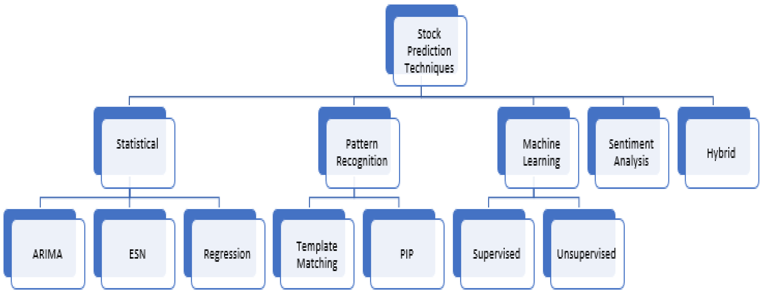
(Cant..)
Figure: Taxonomy of Stock Prediction Techniques
Department of Computer Science and Engineering

Slide 8
Previous Literature:
Various algorithms for machine learning are used to predict stock price trends. Some of them are ANN(Artificial Neural Networks) [3,4,5,6] , GA(Genetic Algorithm) [5], LS-SVM(Least Square Support Vector Machine) [1,7], Trend Estimation with Linear Regression (TELR)[8],SVM(support vector machines) [4,6,9] with different kernels, KNN(K Nearest Neighbors) [5]structural support vector machines (SSVMs)[10] . Some statistical analyses are also used like Autoregressive Integrated Moving Average (ARIMA) [11]. But none of them were able to give quite promising prediction due to the non-linearity of the data.
Department of Computer Science and Engineering

Slide 9
Algorithm performance of different models on Stock Price Data
Studies have tried to predict stock prices using Artificial Neural Network. In a study in 2017 [4]on Korean stock market ANN was used to predict the stock price with the highest accuracy of
81.34 percent for 20 days and 83.01 percent for 30 days moving average. In another study [6]
ANN was used and got 86.69% average accuracy based on experiment carried out on three different stocks. In 2018 this study [3] ANN was used and the best SSE score was 0.6271104815 forApple,0.0121281374 for Pepsi, 0.0335425612 for IBM, 0.016770174 for McDonald and 0.0211154625for LG. In this study [4] author used ANN and achieved 96.10 percent accuracy for 5-fold average prediction (Mj`). Mj is a model where 1≤ j ≤ J, for each classifier. And Mj` is a variant model as a ANN substitution of Mj. 92.81 percent accuracy was achieved from model Mj.
Department of Computer Science and Engineering

Slide 10
(Cant..)
Least square support vector machine (LS-SVM) is another popular machine learning used to predict stock prices. In this study [7] author a LS-SVM model along with Particle Swarm
ANN was used and got 86.69% average accuracy based on experiment carried out on three different stocks. In 2018 this study [3] ANN was used and the best SSE score was 0.6271104815 forApple,0.0121281374 for Pepsi, 0.0335425612 for IBM, 0.016770174 for McDonald and 0.0211154625for LG. In this study [4] author used ANN and achieved 96.10 percent accuracy for 5-fold average prediction (Mj`). Mj is a model where 1≤ j ≤ J, for each classifier. And Mj` is a variant model as a ANN substitution of Mj. 92.81 percent accuracy was achieved from model Mj.
Department of Computer Science and Engineering

Slide 11
(Cant..)
Optimization (PSO) and the accuracy rate of the system was around 90.5 – 93%. Another research [1] used LS-SVM with PSO optimization and LS_SVM to predict stock prices. e Mean Squared Error (MSE) was 0.5317 for Adobe, 0.6314 for oracle 0.7725 for HP and 0.7905 And the accuracy r Other potent Machine Learning Algorithms like SVM was u algorithm for three company stocks. For BSE-Sensex the accuracy was 90.10% using polynomial kernel where c=1 and degree =1 and for RBF kernel the accuracy was 88.08 where c=1 gamma=4. For Infosys the accuracy was 89.59% with polynomial kernel where c None of the algorithm we have seen to use in those studies that we have discu accuracy higher than 90 percent except SVM optimized with PSO [7]. In that research a highest accuracy of 90.5 to 93 percent was found. One study was Found which has used Bangladeshi stock price data to predict stock price. =1 and degree=1 and 87.80% for RBF kernel where c=5 and gamma=1.5. Another research [9] that used SVM with RBF kernel has the mean accuracy of 53.3% to 56.8% for 10 days.
Department of Computer Science and Engineering

Slide 12
Research gap
modified linear regression algorithm Trend Estimation with Linear Regression was used in this
study [8] and Mean Absolute Percentage Error (MAPE) was 5.41% for bank data and 5.42% for
overall stock data. K Nearest Neighbors or KNN is also been used to predict stock prices
Structural support vector machines(SSVMs) is used in a research and the accuracy with training samples was higher than 78% and the accuracy with testing samples was about 50%
None of the algorithm we have seen to use in those studies that we have discussed had an accuracy higher than 90 percent except SVM optimized with PSO [7]. In that research a highest accuracy of 90.5 to 93 percent was found. One study was Found which has used Bangladeshi stock price data to predict stock price.
Department of Computer Science and Engineering

Slide 13
Objective
Over the previous few decade, many social science researches have focused o predicting social and financial development tendencies with quantitative method.. Many viable techniques in time-series analysis each with benefits and disadvantages, can be interpreted as method for using past facts to construct forecasts and strategies on future value. Based on all of this, this paper takes data to forecast the future stock price forecast models so as to formulate the most advantageous funding approach for investors to refer to at a positive extent. For this motive we have develop web based application used python scripting language, Django Framework ,JavaScript, HTML,CSS, which has a speedy execution on what shares money have to be invested . It will also help in maintaining to most ecumenical stability of the share market.
  To Make a comparative study of deferent of machine learning algorithms to predict the future stock price of companies , starting with simple algorithms like Random forest, and then move on to advanced techniques like ARIMA, LSTM, bidirectional LSTM.
  To develop a Web Application of predicting of future stock price. Interactive User Interface for Chart, Prediction Search Menu, Analysis Report. User and admin login UI .
Department of Computer Science and Engineering

Slide 14
Most investors put their money into stocks based on intuition or pure guesswork, hoping that the price will go up and they make a profit. It doesn’t happen and moime you face a loss. Losses can be minimized if you know how to use the investors put their money into stocks based on intuition or pure guesswork, hoping that the price will go up and they make a profit. It doesn’t happen and most of the time you face a loss. Losses can be minimized if you know how to use the right forecasting strategy correctly. Stock market forecasts help investors achieve consistency as traders as they aim to make more money than they lose in this volatile market. Applying the correct stock prediction technique will help investors know better about entry and exit points. So often the traders either enter or exit the market at the wrong time which means they fail to capitalize on the full potential of making profits. These days more and more critical information about the stock market has become available on the Web [3]. Therefore, people are getting inﬂuenced by others’ opinions and information and making decisions accordingly. decisions accordingly.
Problem Description
Department of Computer Science and Engineering

Slide 15
Nowadays, advanced intelligent techniques based on either technical or fundamental
Dataset Preparation
Nowadays, advanced intelligent techniques based on either technical or fundamental analysis
are used for predicting stock prices [4]. Hence, the upcoming stock price prediction
system will help investors in decision making for which company’s stock to invest
into and that it will eventually help them gain more profit and refrain them from
choosing companies which will not be feasible for them to invest in.
Building the information set is one of the most challenging tasks of any machine
learning project. The struggle gets even scarier when we don’t have any benchmark
information set for our issues. Presently, building a data set can be exhausting in
some diverse ways. I will brieﬂy examine the ins and outs of each technique and our
selections among them.
Department of Computer Science and Engineering

Slide 16
Optimization (PSO) and the accuracy rate of the system was around 90.5 – 93%. Another research [1] used LS-SVM with PSO optimization and LS_SVM to predict stock prices. e
Data Collection
There are huge depots of datasets collected from stock exchanges all over the world. As mentioned before, in our country there are two stock exchanges, DSE and CSE.
And, we have selected to do our analysis on DSE only. The website contains data
archives of more than 600 trading companies participating in the stock market. Figure 4.1 shows a glimpse of the dataset that is available on the DSE official website.
The description of the attributes included in this dataset are as follows:
VOLUME : It is the number of shares of a security traded during a given
period of time.
LOW : The lowest price that a stock trades on that day.
OPENP* : Opening Price
CLOSEP* : Closing Price
YCP : Yesterday’s Opening Price
TRADE : Name of the stock trading company
VALUE (mn) : shares of a company
LTP* : Last Traded Price
HIGH : The highest price at which a stock traded during the course of the
trading day
Department of Computer Science and Engineering

Slide 17
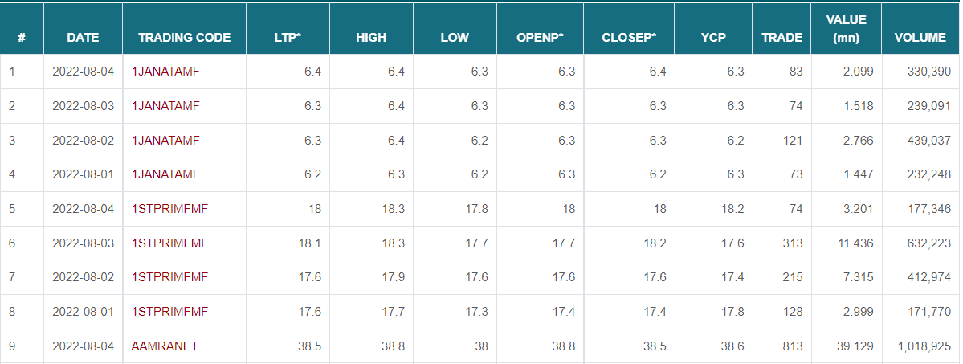
Cant..
Optimization (PSO) and the accuracy rate of the system was around 90.5 – 93%. Another research [1] used LS-SVM with PSO optimization and LS_SVM to predict stock prices. e
Figure 4.1: Data Archive from Dhaka Stock Exchange (DSE
Department of Computer Science and Engineering

Slide 18
Scraping the web
Now that we have data available on the website, it will be cumbersome to individually copy and paste the row wise data from the website directly. In order to save time and energy, we can attempt this step to load a huge amount of data for our dataset
is used to extract content from an HTML page.
Three basic steps are required to be followed in order to undergo the web scraping process.have to extract the HTML content. After analyzing the HTML structure and identifying the tags which have our content, we then extract the tags using Beautiful Soup and put the data in a Python list. Thats how we obtained our dataset.
Department of Computer Science and Engineering

Slide 19
Data Pre Processing
Before feeding the dataset, it requires a few pre-processing steps. firstly, we had to convert the date column within the dataset to date time format. Then we created a separate data frame where we removed the column containing the trading codes. Here trading codes are the companies that are involved in the stock trading. We also had to clean the separated data frame that didn’t contain the company name column. We removed all commas and spaces in between the values within the dataset. Form hour list, we then selected five stock companies with which we are going to implement to implement this project. Then all prices that were prior to 2022 were considered as our training set and the rest of that data has been used as the test set.
Department of Computer Science and Engineering

Slide 20
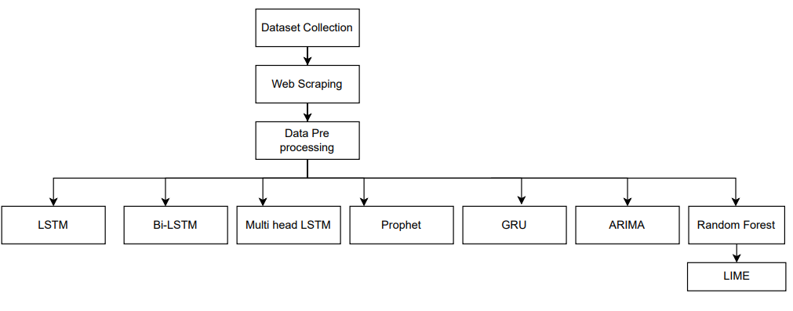
Methodology
Process Flow
Figure Work flow Diagram
Department of Computer Science and Engineering

Slide 21
LSTM(Long Sort -Term Memory)
Standard Recurrent Neural Networks (RNNs) are affected by short-time period memory because of a vanishing gradient trouble that emerges whilst operating with longer information sequences. Luckily, we’ve got greater superior variations of RNNs that could maintain vital statistics from in advance elements of the series and convey it forward. The best-regarded variations are Long Short-Term Memory (LSTM) and Gated Recurrent Units (GRU). It addressed the difficulty of RNN long-time period dependency, wherein the RNN is unable to expect words saved in long-time period reminiscence however could make extra correct predictions primarily based totally on contemporary statistics RNN now no longer oﬀers a green overall performance as the space duration rises. The LSTM may also hold data for a long term through default. It is used for time-collection statistics processing, prediction, and classification.
Department of Computer Science and Engineering

Slide 22
Cant..
Let me begin with a brief recap of a simple RNN structure. RNN includes more than one layer just like a Feed-Forward Neural Network: the enter layer, hidden layer(s), and output layer as shown in Figure 3. However, RNN contains recurrent units in its hidden layer, which lets in the set of rules to process series data. It doe sit with the aid of frequently passing a hidden state from a previous timestep and mixing it with an input of the cutting-edge one. However, RNN contains recurrent units in its hidden layer, which lets in the set of rules to process collection data. Itdoes it via means of commonly passing a hidden state from a previous timestep and mixing it with an entry of the present day one.
Department of Computer Science and Engineering

Slide 23
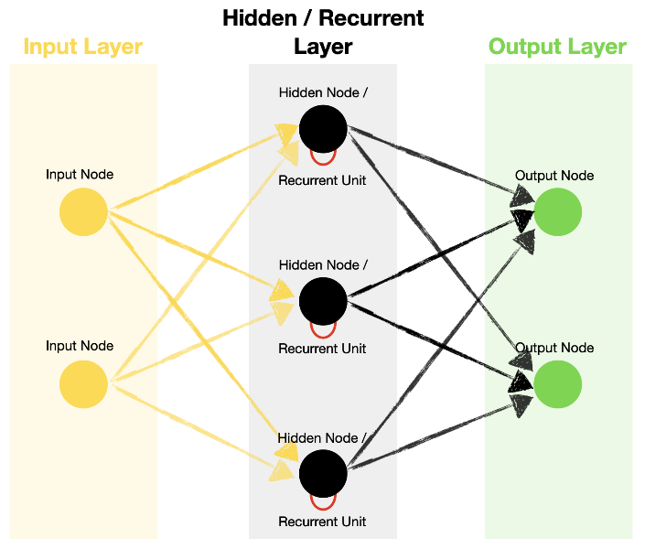
Cant..
Figure Standard Recurrent Neural Network architecture
Department of Computer Science and Engineering

Slide 24
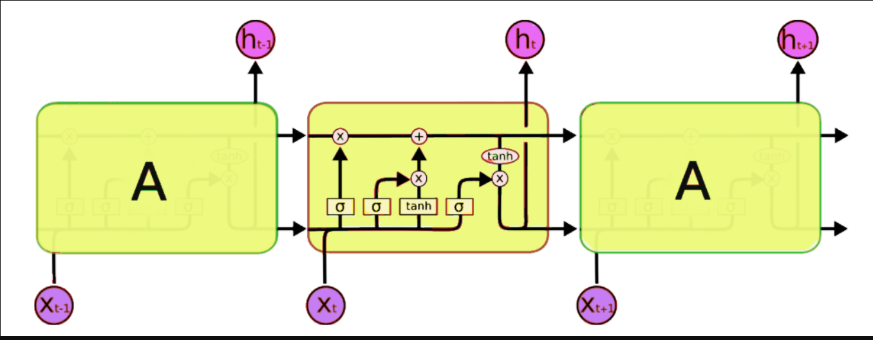
Cant..
Figure Architecture of LSTM
Department of Computer Science and Engineering

Slide 25
Cant..
There are three entrances:
Input Gate: It determines which of the input values should be used to change the
memory. The sigmoid function determines whether to allow 0 or 1 values through.
And the tanh function assigns weight to the data provided, determining their importance on a scale of -1 to 1.
it = σ(Wi.[ht - 1, xt] + bi) (5.1)
Ct = tanh(Wc.[ht - 1, xt] + bc) (5.2
Forget Gate: It fnds the details that should be removed from the block. It isdecided by a sigmoid function. For each number in the cell state Ct - 1, it looks at the preceding state (ht - 1) and the content input (Xt) and produces a numberbetween 0 and 1.
Department of Computer Science and Engineering

Slide 26
Cant..
ft = σ(Wf.[ht - 1, xt] + bf ) (5.3)
Output Gate: The block’s input and memory are used to determine the output.
The sigmoid function determines whether to allow 0 or 1 values through. And the
tanh function determines which values are allowed to pass through 0, 1. And the
tanh function assigns weight to the values provided, determining their relevance on
a scale of -1 to 1 and multiplying it with the sigmoid output
Ot = σ(Wo.[ht - 1, xt] + bo) (5.4)
ht = ot ∗ tanh(Ct) (5.5
Department of Computer Science and Engineering

Slide 27
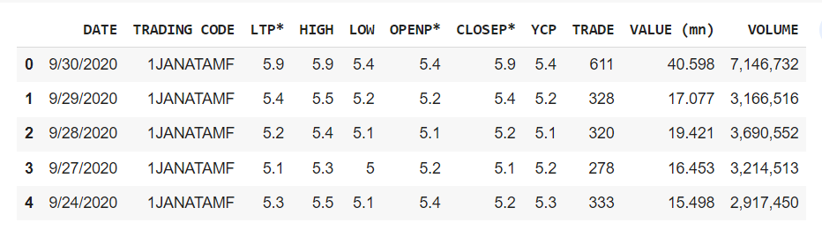
Implementation and result analysis
Figure Snippet of the Data frame
Department of Computer Science and Engineering

Slide 28
Cant..
After rigorous data processing as explained in section 4, there is a need to extract
the feature which is required for data analysis, then divide it as testing and training
data, training the algorithms to predict the price and the final step is to visualize
the data. First, we trained our LSTM model using the training dataset which as
mentioned before contained data prior to 2022 as a testing test for five selected
companies.
A cell, an information door, an entrance door, and a door with a view make up a
standard LSTM unit. The three inputs control how quickly data centers and leaves
the cell as the cell collects values over arbitrary time intervals. The LSTM’s ability
to learn context-specific temporal dependency is its key benefit. Without explicitly
applying the activation function within the recurrent components, each LSTM unit
gathers data for either a lengthy or brief duration (thus the name). It is important
to keep in mind that every cell state is significantly amplified by the output of the
ignored entrance, which ﬂuctuates between 0 and 1. Feature scaling on the dataset
is done so that the data values vary from 0 and 1.
Department of Computer Science and Engineering

Slide 29
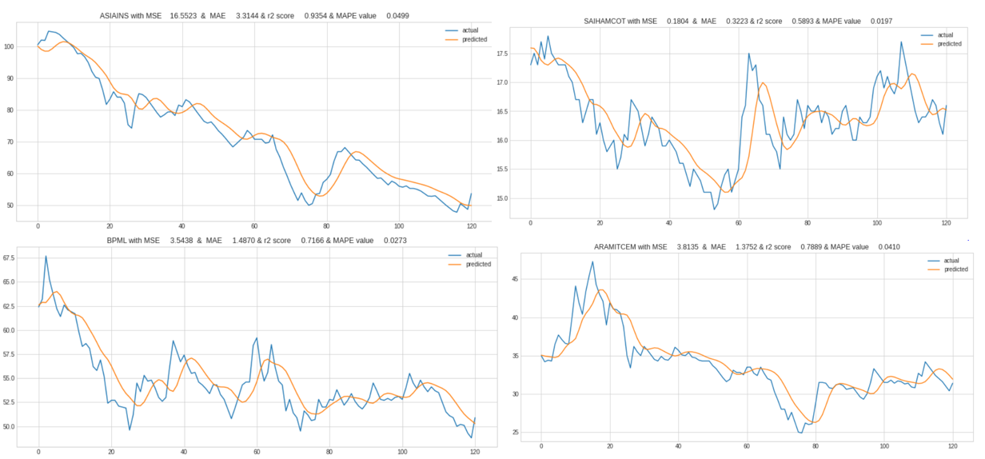
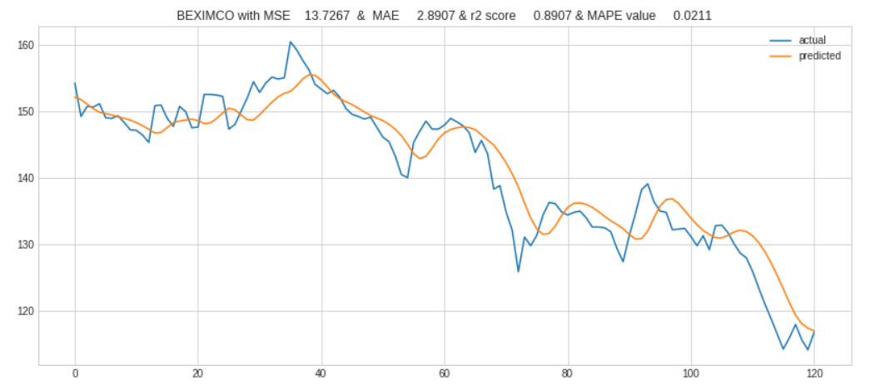
Result Analysis
The suggested LSTM model is implemented in Python and uses past data to forecast
the price of BPML, ASIAINS, SAIHAMCOT, ARAMITCEM and BEXIMCO shares
in the future. The visualization of all these company forecasts is shown in the images
below. The graph below which is Figure 6.2, from our algorithm will display the
expected price of all the five company shares in our paper, which implements an
algorithm that predicts the stock price of a share for a specific length of time.
Plotted from the output of our algorithm using LSTM units to achieve accuracy is
the result shown in the graph below.
Figure: Results from LSTM Model
Figure : Results from LSTM Model on BEXIMCO
Department of Computer Science and Engineering

Slide 30
Tools/Technology
Stock Market Prediction Web based project need a lot of library and programing language which use for imported data analysis.
In this project I am using Python programing language and Django framework for web base project perform.
Language: Backend
Python
Framework: Django
Frontend: HTML, CSS, Bootstrap, JavaScript,
Data analysis Library:
Pandas – This library helps to load the data frame in a 2D array format and has multiple functions to perform analysis tasks in one go.
Numpy – Numpy arrays are very fast and can perform large computations in a very short time.
Matplotlib/Seaborn – This library is used to draw visualizations.
Department of Computer Science and Engineering

Slide 31
Budget Estimation:
In this section to estimation potential budget for implements this project
Sl | Description | Quantity | Price
1 | Laptop i7 12gth gen with SSD, mouse ,keyboard | 1 Nos | 85000
2 | Domain and hosting | 1 Nos | 3000
3 | Report ,printing cost | 1 nos | 2000
4 | Entertainment | No specific | 5000
5 | Consultant fee (Data analysis and market survey) | No specific | 15000
Total |  |  | 110000
So, approximately need 110000 (one lakhs teen thousands) for prepared this project
Department of Computer Science and Engineering

Slide 32
Recommendations for Future Work
We leveraged the combinations of price, volumes and corporate statistics as input data.
We proposed, developed, trained and tested four models: LSTM, Bi-LSTM, Multihead LSTM, ARIMA, and Prophet And build up Long-Only and Long-short trading strategies according to our model predictions
The research used DSE stocks historical data for the past years from September, 2020, to July 2022, to compare the multi models’ results. The ARIMA model shows more superior results over other models due its ability to assign diﬀerent weights to the input features hence automatically choose the most relevant features
Hence the ARIMA model is more able to capture the long-term dependence in the time series and more suitable in predicting financial time series. Our superior trading return from ARIMA model further validates
One difficulty of predicting stock market arises from its non-stationary behavior. It would be interesting to see how ARIMA performs on demised data. Moreover, in future more fine tuning of the models can provide us more accurate results in the
future. Presently this project (Stock Market Price Prediction) made by python and Django framework .so its need to move in future to build API (Application Programmable Interface) for real time access web platform and mobile platform.
Department of Computer Science and Engineering

Slide 33
References
1.Hegazy, O., Soliman, O. S., & Salam, M. A. (2014). A machine learning model for
stock market prediction. arXiv preprint arXiv:1402.7351,
2. Guo, K., Sun, Y., & Qian, X. (2017). Can investor sentiment be used to predict the stock
price? Dynamic analysis based on China stock market. Physica A: Statistical Mechanics
and its Applications, 469, 390-396.
3. Ebadati, O. M. E., & Mortazavi, M. T. (2018). An efficient hybrid machine learning
method for time series stock market forecasting. Neural Network World, 28(1), 41-55.
4. Qian, B., & Rasheed, K. (2007). Stock market prediction with multiple classifiers.
Applied Intelligence, 26(1), 25-33.
5. Pyo, S., Lee, J., Cha, M., & Jang, H. (2017). Predictability of machine learning
techniques to forecast the trends of market index prices: Hypothesis testing for the
Korean stock markets. PloS one, 12(11), e0188107.
Department of Computer Science and Engineering

Slide 34
Cant..
6. Patel, J., Shah, S., Thakkar, P., & Kotecha, K. (2015). Predicting stock and stock price
index movement using trend deterministic data preparation and machine learning
techniques. Expert Systems with Applications, 42(1), 259-268.
7. Efat, M. I. A., Bashar, R., Uddin, K. I., & Bhuiyan,(2018) T. Trend Estimation of Stock
Market: An Intelligent Decision System. International Conference on Cyber Security
and Computer Science.
8. Madge, S., & Bhatt, S. (2015). Predicting stock price direction using support vector
machines. Independent work report spring.
9. Leung, C. K. S., MacKinnon, R. K., & Wang, Y. (2014, July). A machine learning
approach for stock price prediction. In Proceedings of the 18th International Database
Engineering & Applications Symposium (pp. 274-277). ACM.
Department of Computer Science and Engineering

Slide 35

THANK YOU
Department of Computer Science and Engineering

